Slide 1
Aging and heat vulnerability
Older adults are particularly vulnerable to heat
          Meade, Robert D., Ashley P. Akerman, Sean R. Notley, et al. 2020. “Physiological Factors Characterizing Heat-Vulnerable Older Adults: A Narrative Review.” Environment International 144 (November): 105909. https://doi.org/10.1016/j.envint.2020.105909.
          Salesse, Camille. 2026. “Who Suffers the Heat? Partial Adaptation and Persistent Inequalities in France.” Ecological Economics 241 (March): 108873. https://doi.org/10.1016/j.ecolecon.2025.108873.
Population aging is a key variable in scenarios of global vulnerability to heat

Slide 2
Litterature review and research question
Numerous scenarios have been made, by combining demographic projections and climate projections
  Chen, Kai, Evan de Schrijver, Sidharth Sivaraj, et al. 2024. “Impact of Population Aging on Future Temperature-Related Mortality at Different Global Warming Levels.” Nature Communications 15 (1): 1796. https://doi.org/10.1038/s41467-024-45901-z.
  Chen, Xiao, Song Leng, Zhaowu Yu, and Ranhao Sun. 2025. “Global Aging Exacerbates Heat Exposure Risk across Diverse Socioeconomic Pathways.” Geography and Sustainability 6 (5): 100318. https://doi.org/10.1016/j.geosus.2025.100318.
  Falchetta, Giacomo, Enrica De Cian, Ian Sue Wing, and Deborah Carr. 2024. “Global Projections of Heat Exposure of Older Adults.” Nature Communications 15 (1): 3678. https://doi.org/10.1038/s41467-024-47197-5.
  Kang, Yeji, Jongchul Park, and Dong-Ho Jang. 2024. “Compound Impact of Heatwaves on Vulnerable Groups Considering Age, Income, and Disability.” Scientific Reports 14 (1): 24732. https://doi.org/10.1038/s41598-024-75224-4.
  Wu, Xilin, Jun Wang, Yong Ge, et al. 2025. “Future Heat-Related Mortality in Europe Driven by Compound Day-Night Heatwaves and Demographic Shifts.” Nature Communications 16 (1): 7420. https://doi.org/10.1038/s41467-025-62871-y.
However, assessing heat exposure of elderly people is difficult, because both the temperature and the place of residence of elderly people are heterogenous within cities
Research question: To what extent should we take into account these heterogeneities when assessing the evolution of elderly people to heatwaves?
Methodology:
  Case study on Paris urban area (~12 million inhabitants, population is aging)
  Simulation of daily temperatures, taking into account land use changes in the city

Slide 3
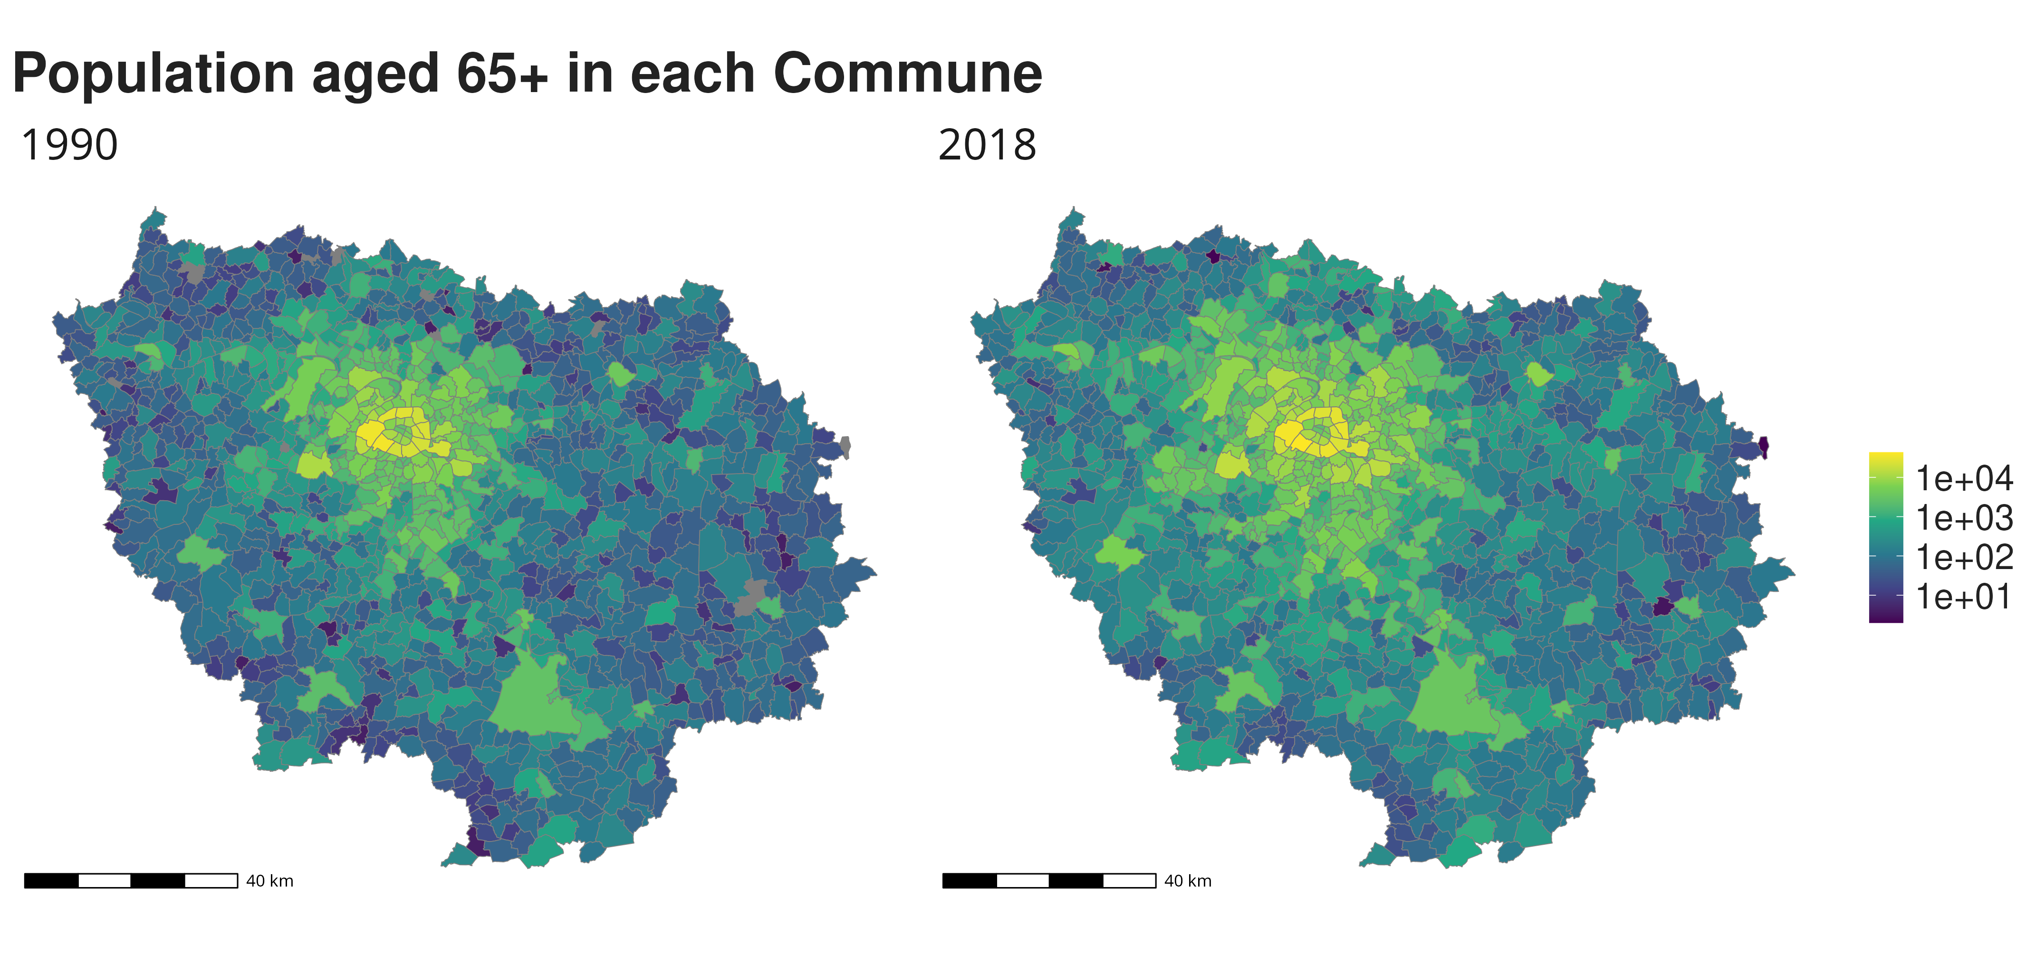
An evolving population

Slide 4
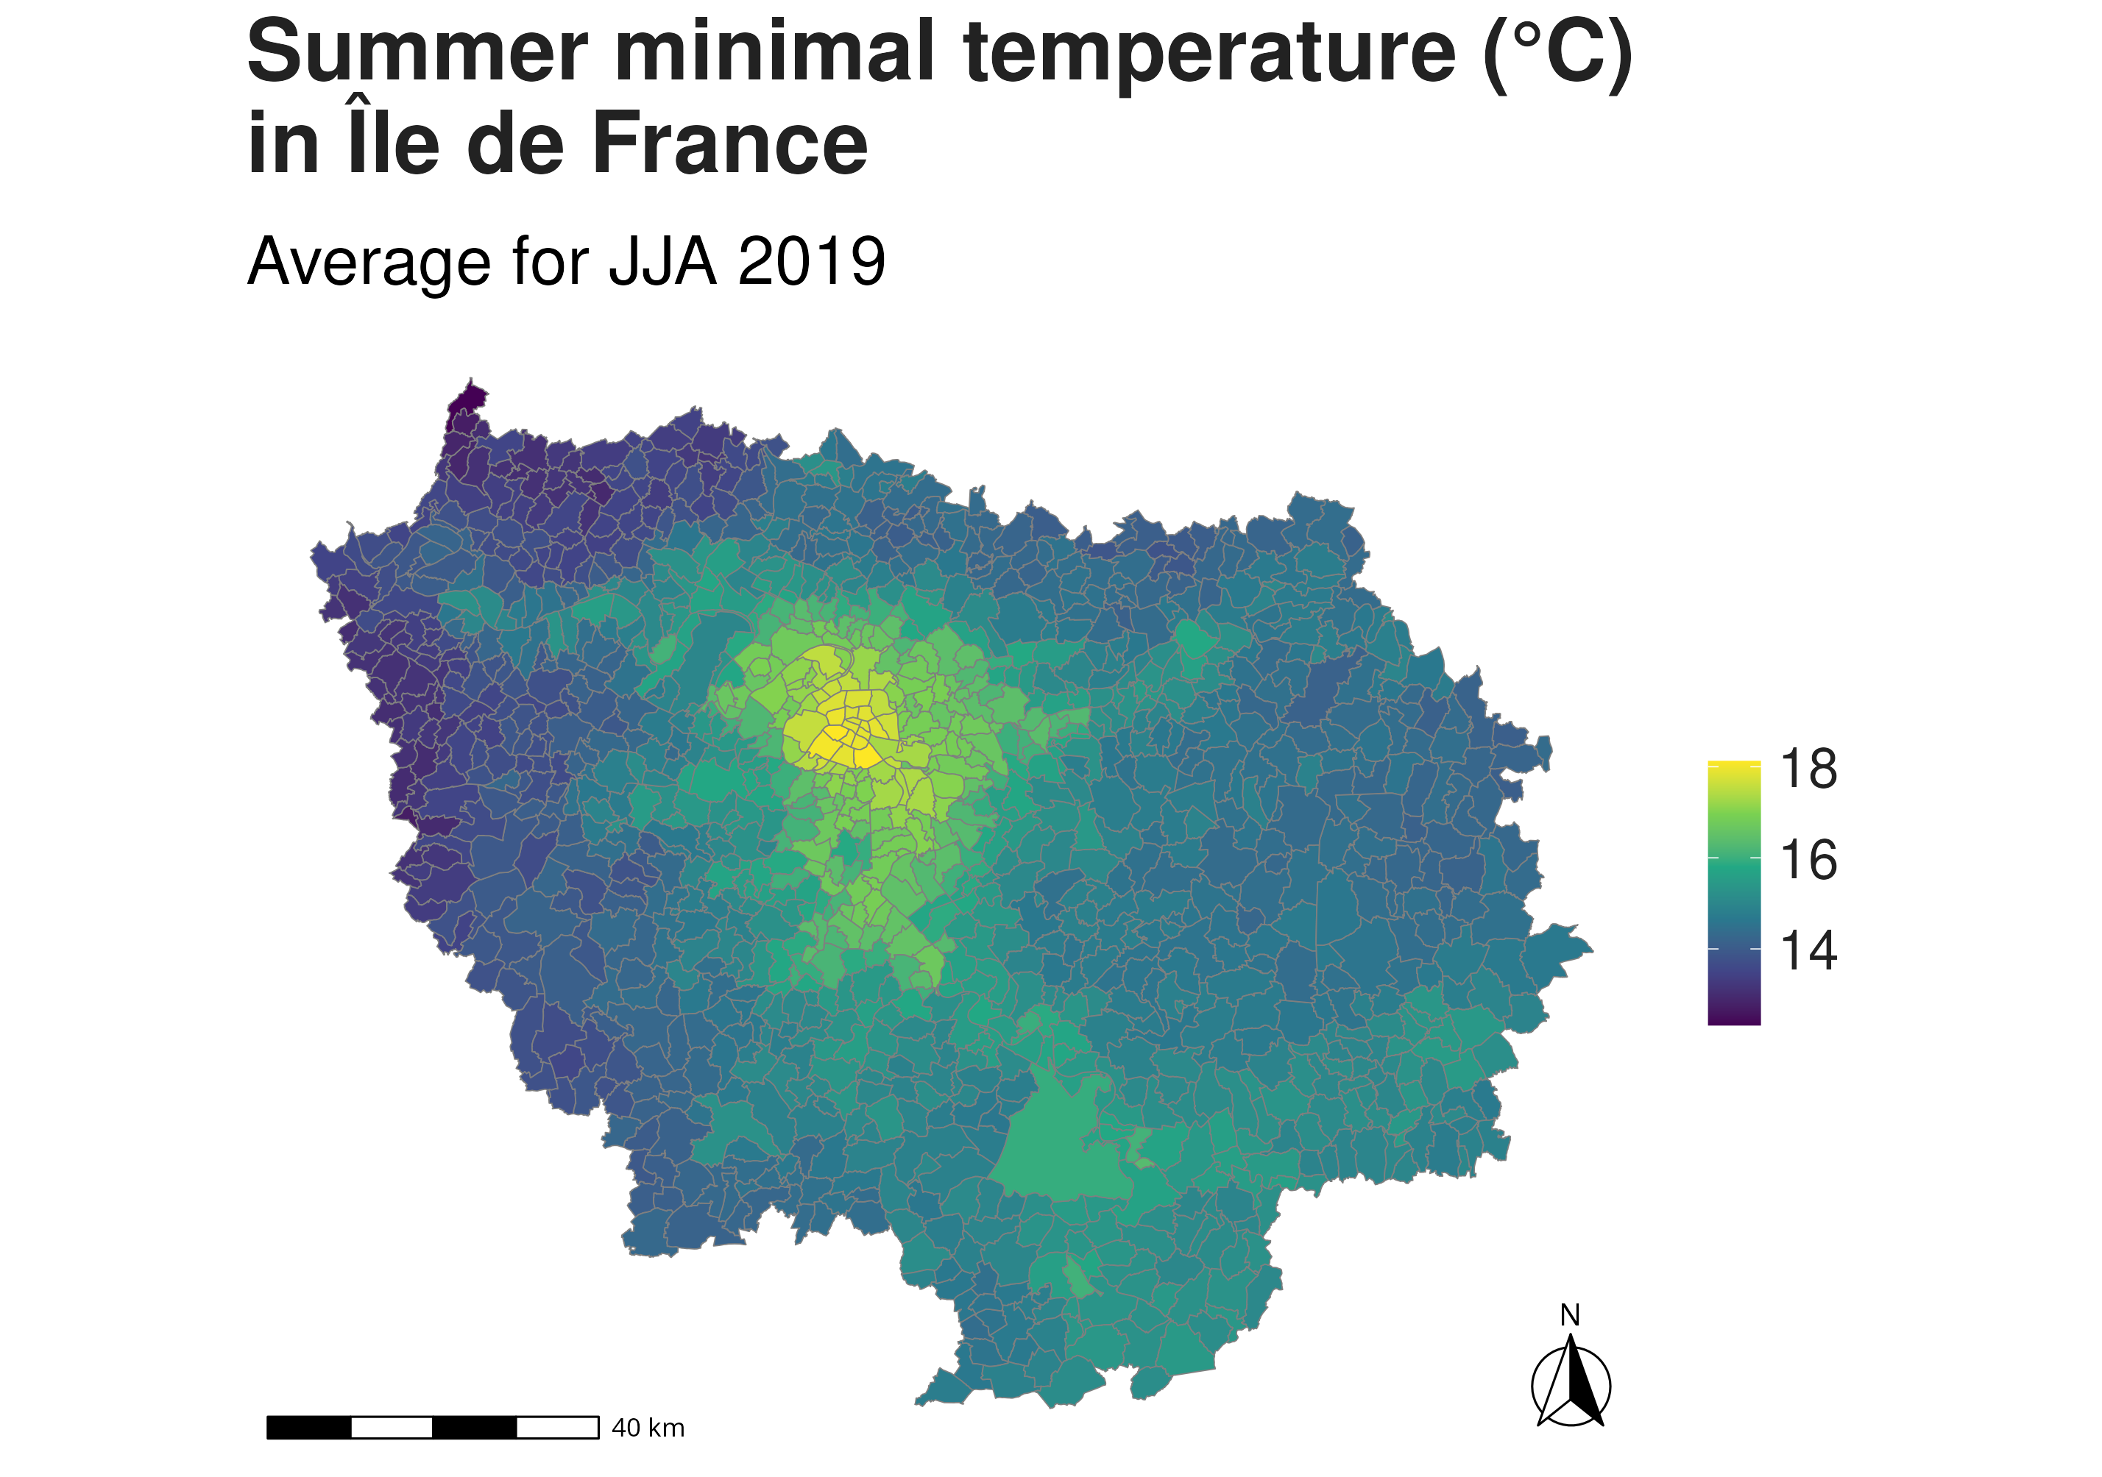
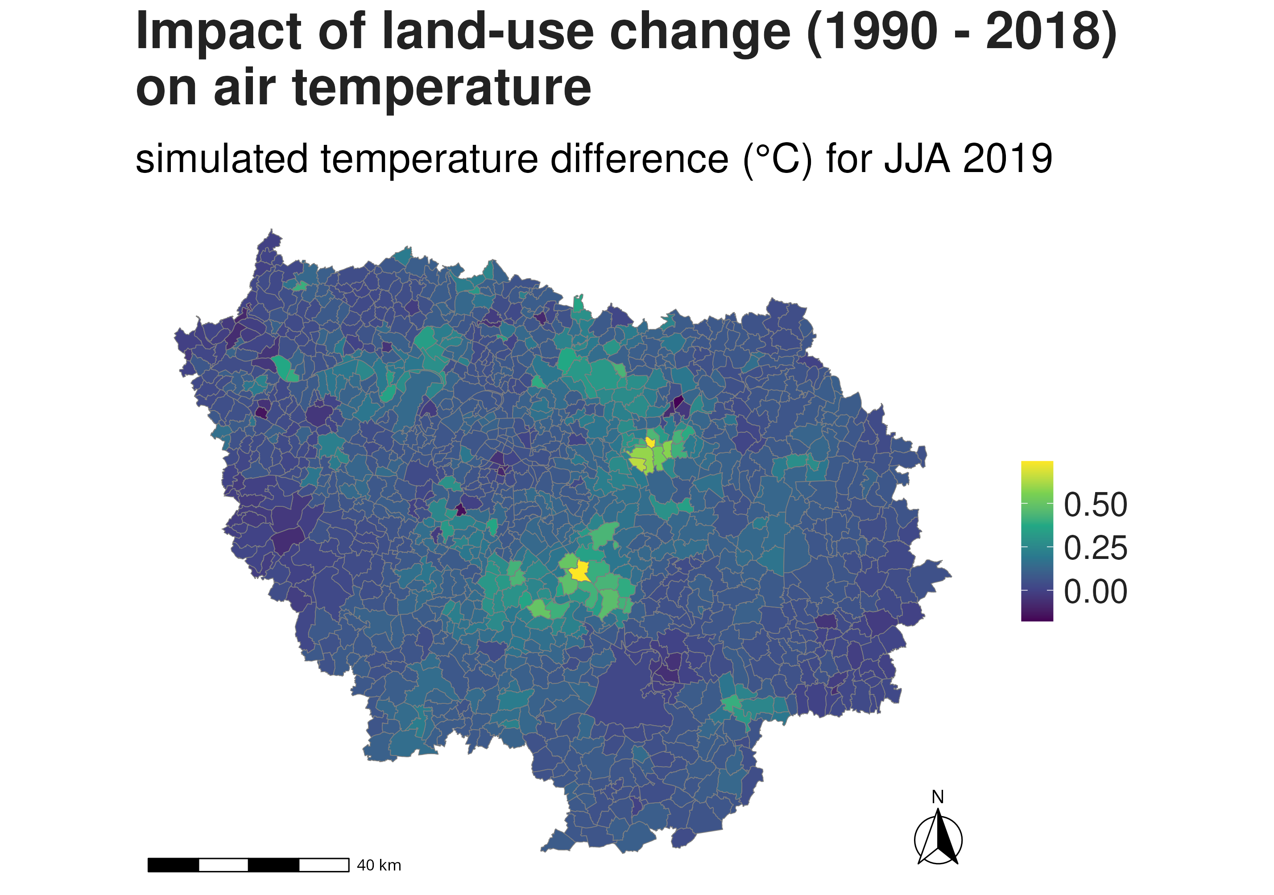
Temperatures impacted by land use

Slide 5
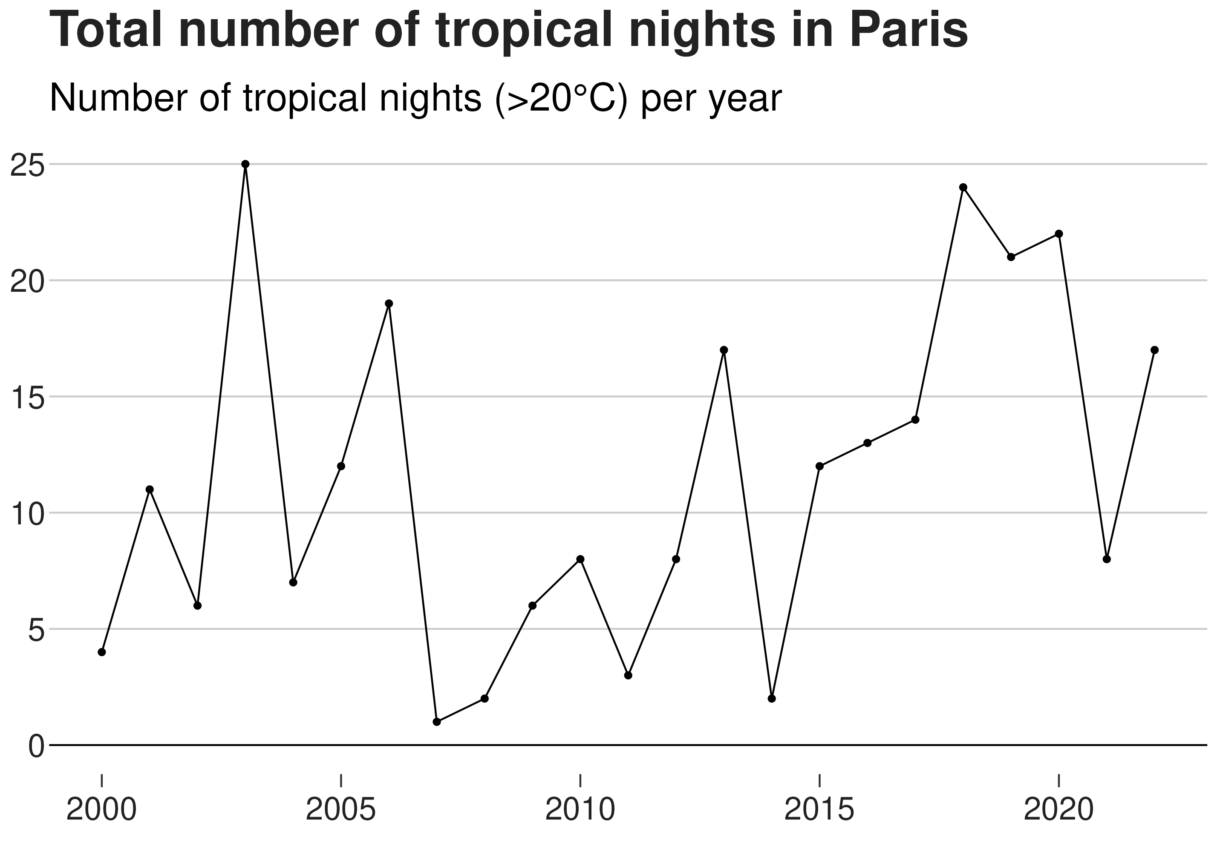
Focus on 5 summers

Slide 6
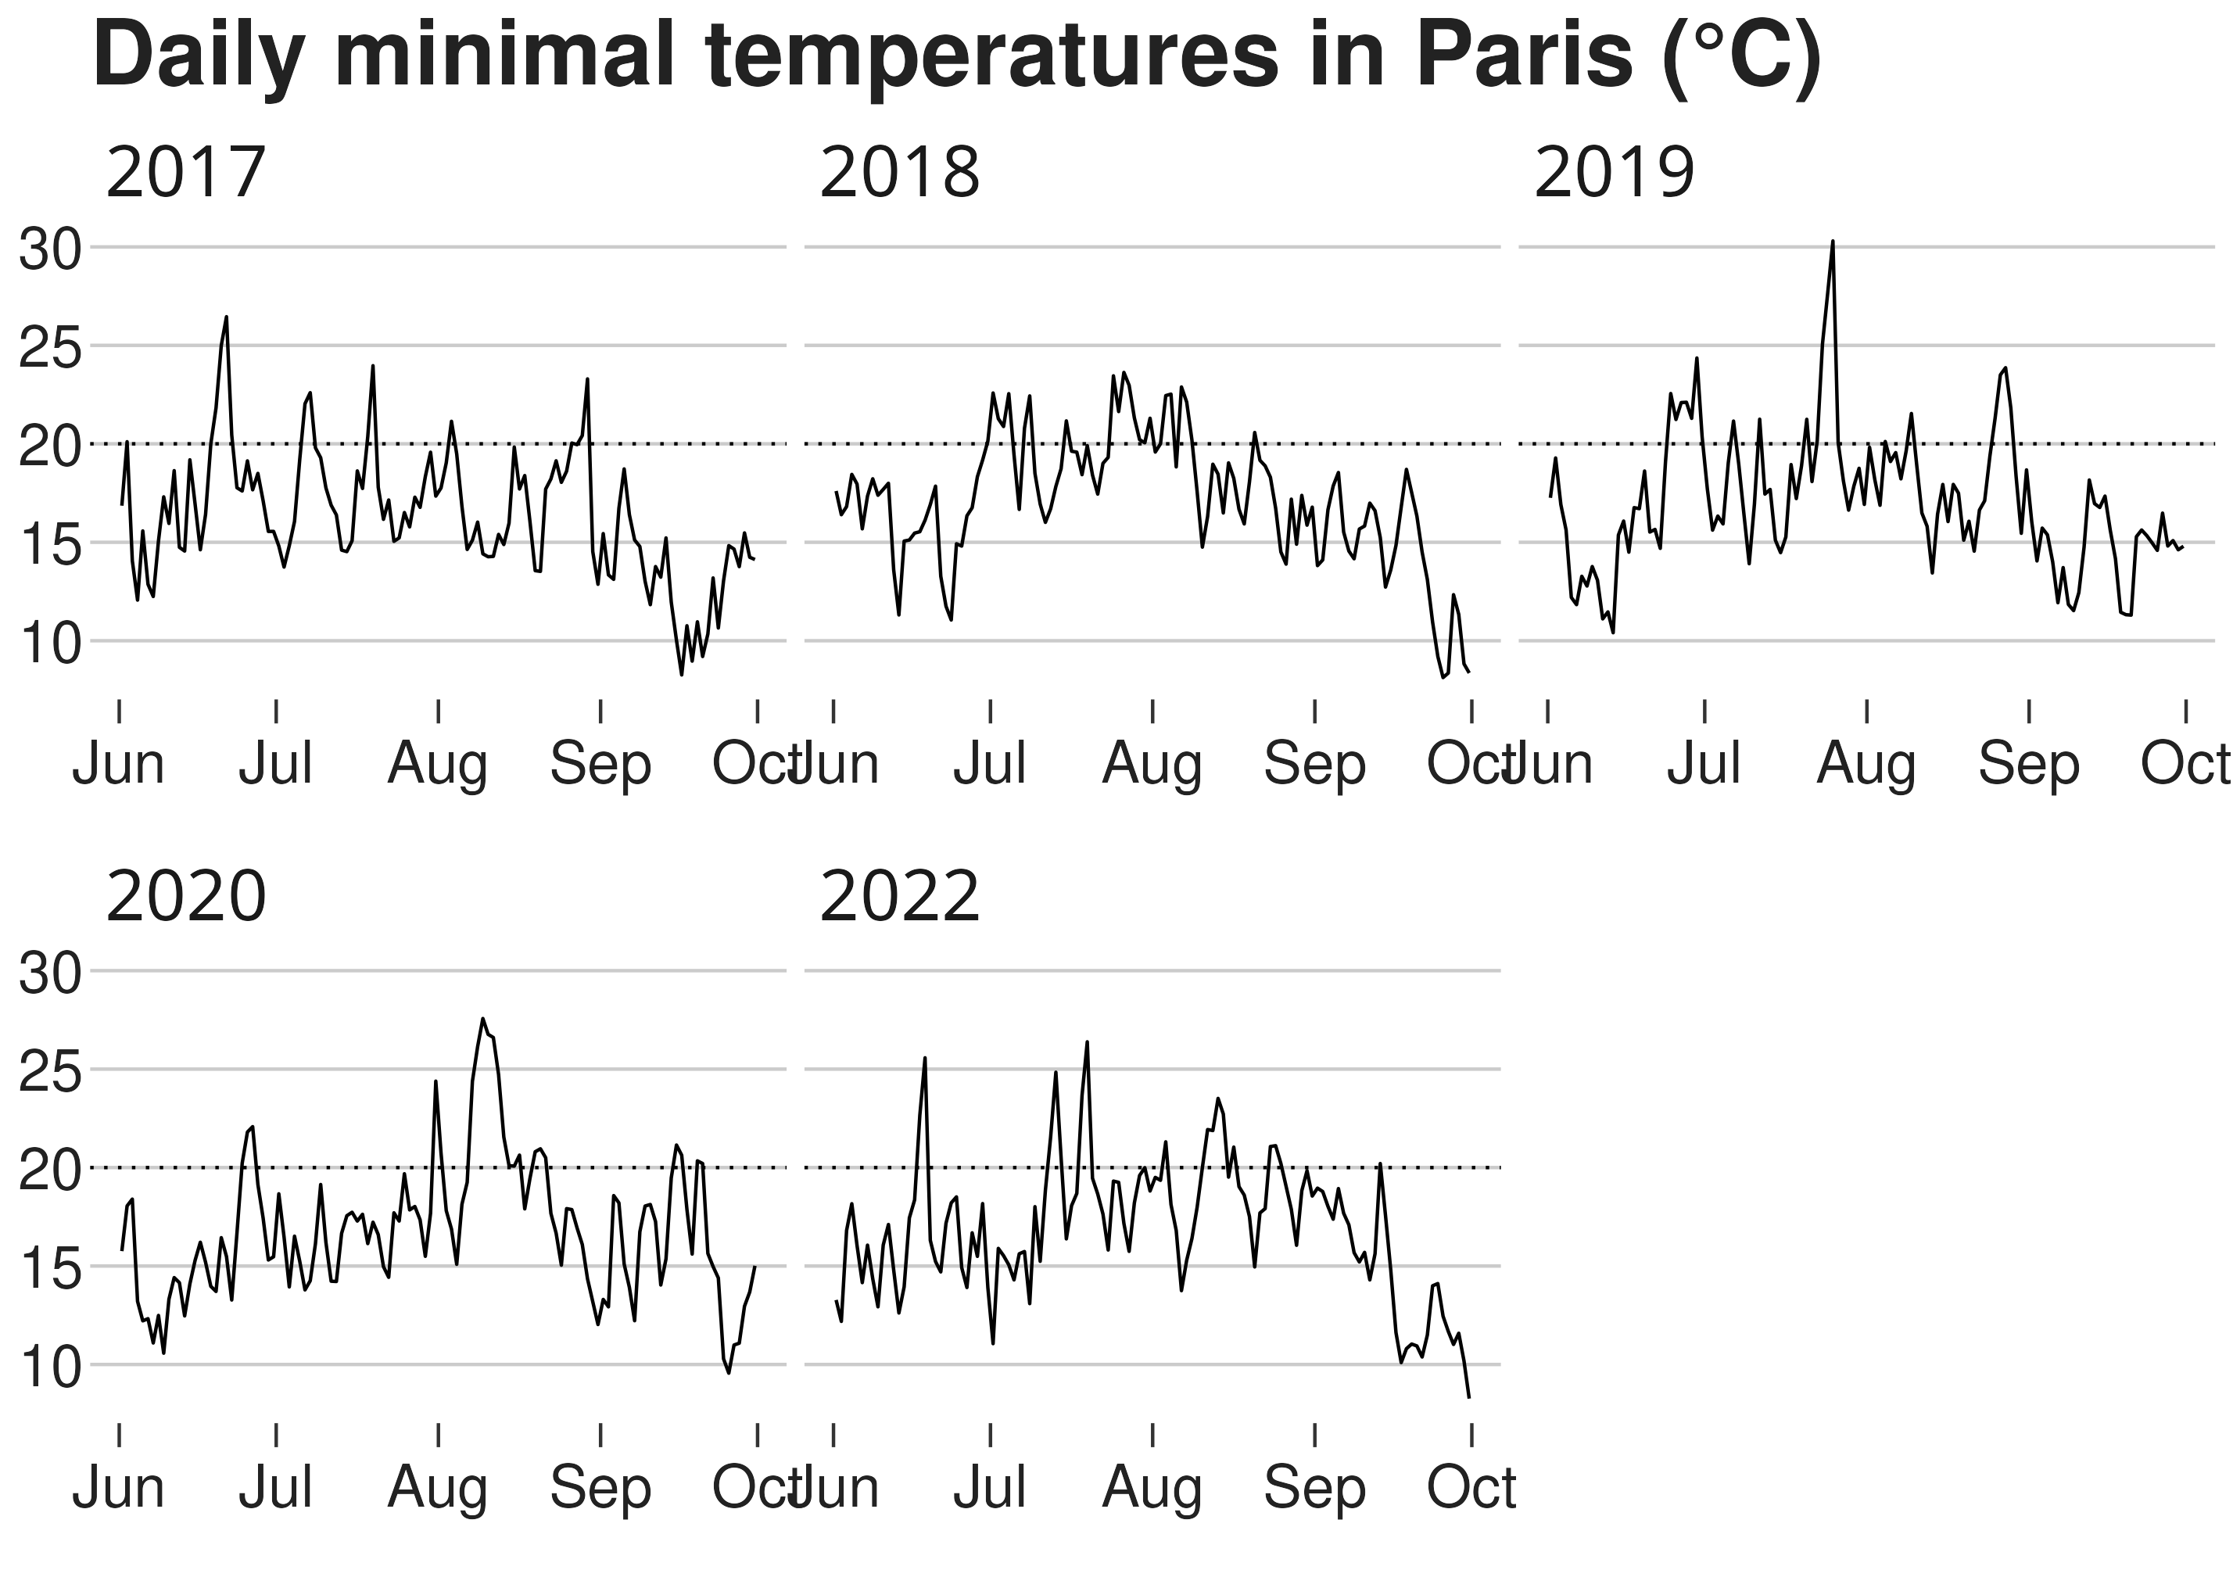
Focus on 5 summers

Slide 7
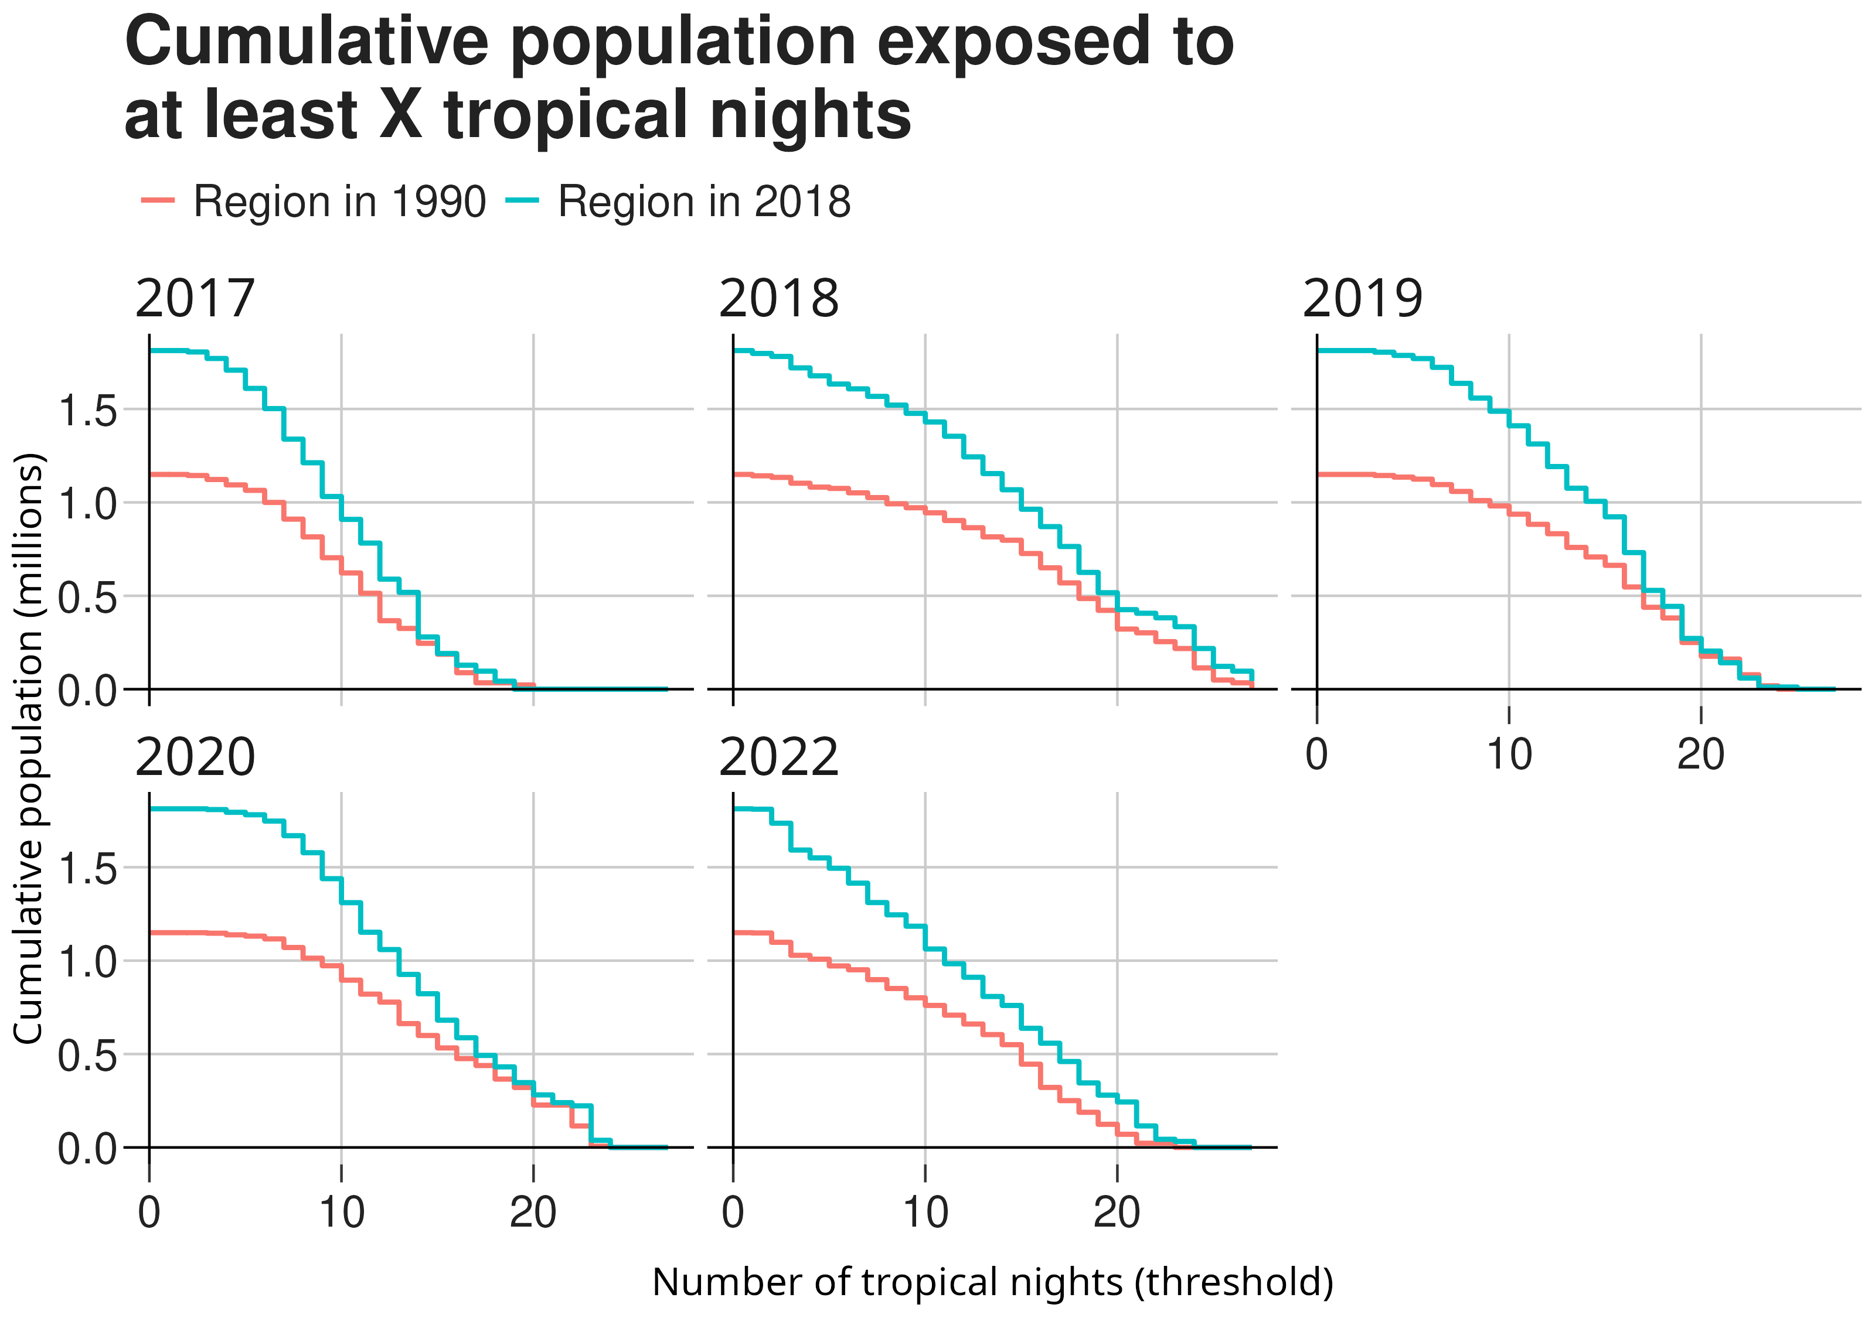
Unequal exposure of the population
Considering population and land use of 2018 leads to a much higher exposure than population and land use of 1990
Why ? —> decomposition of changes due to different factors

Slide 8
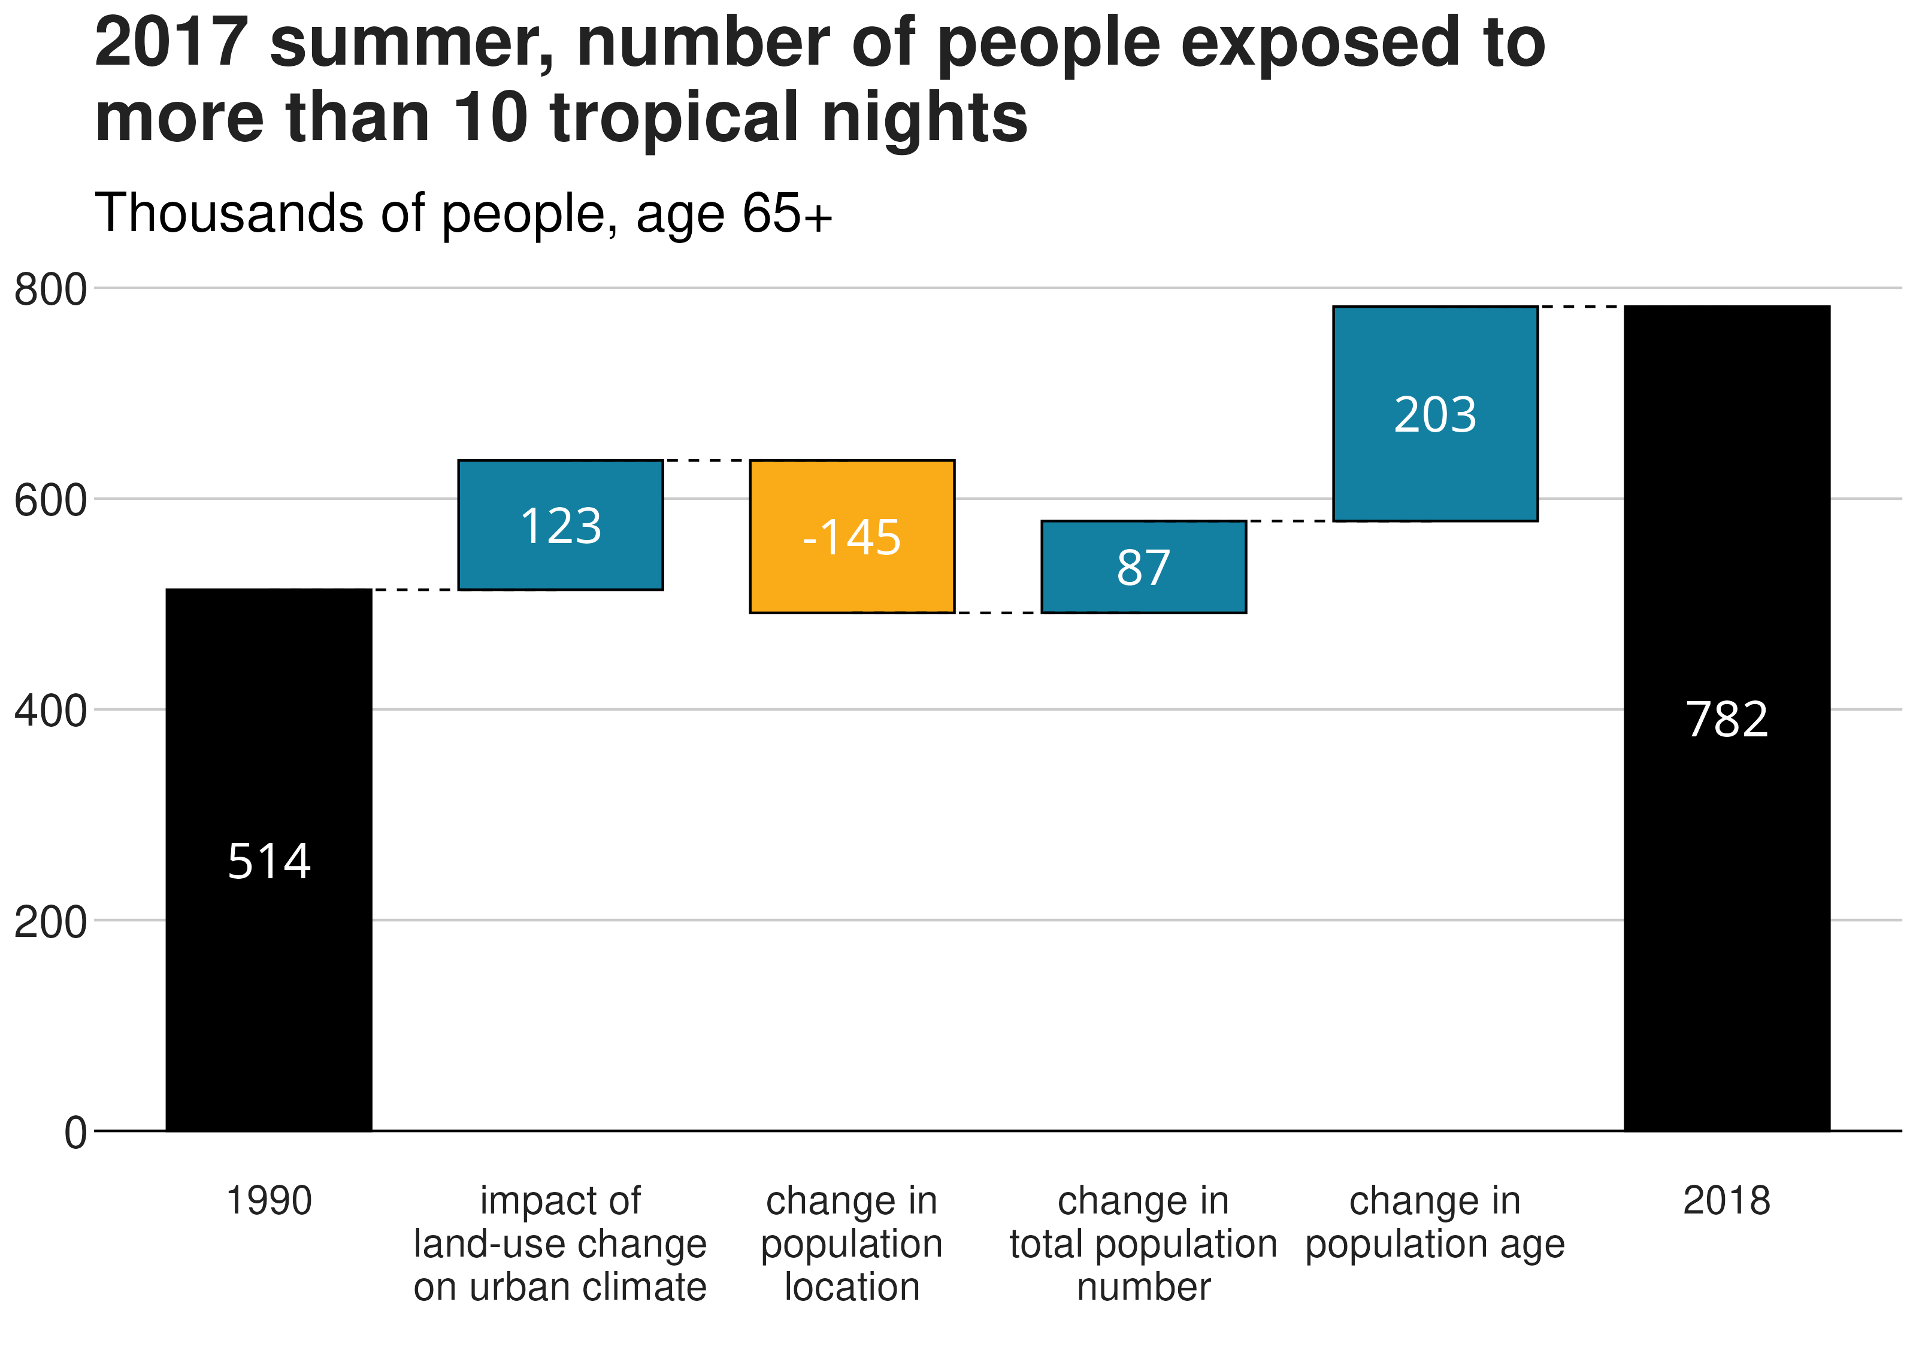
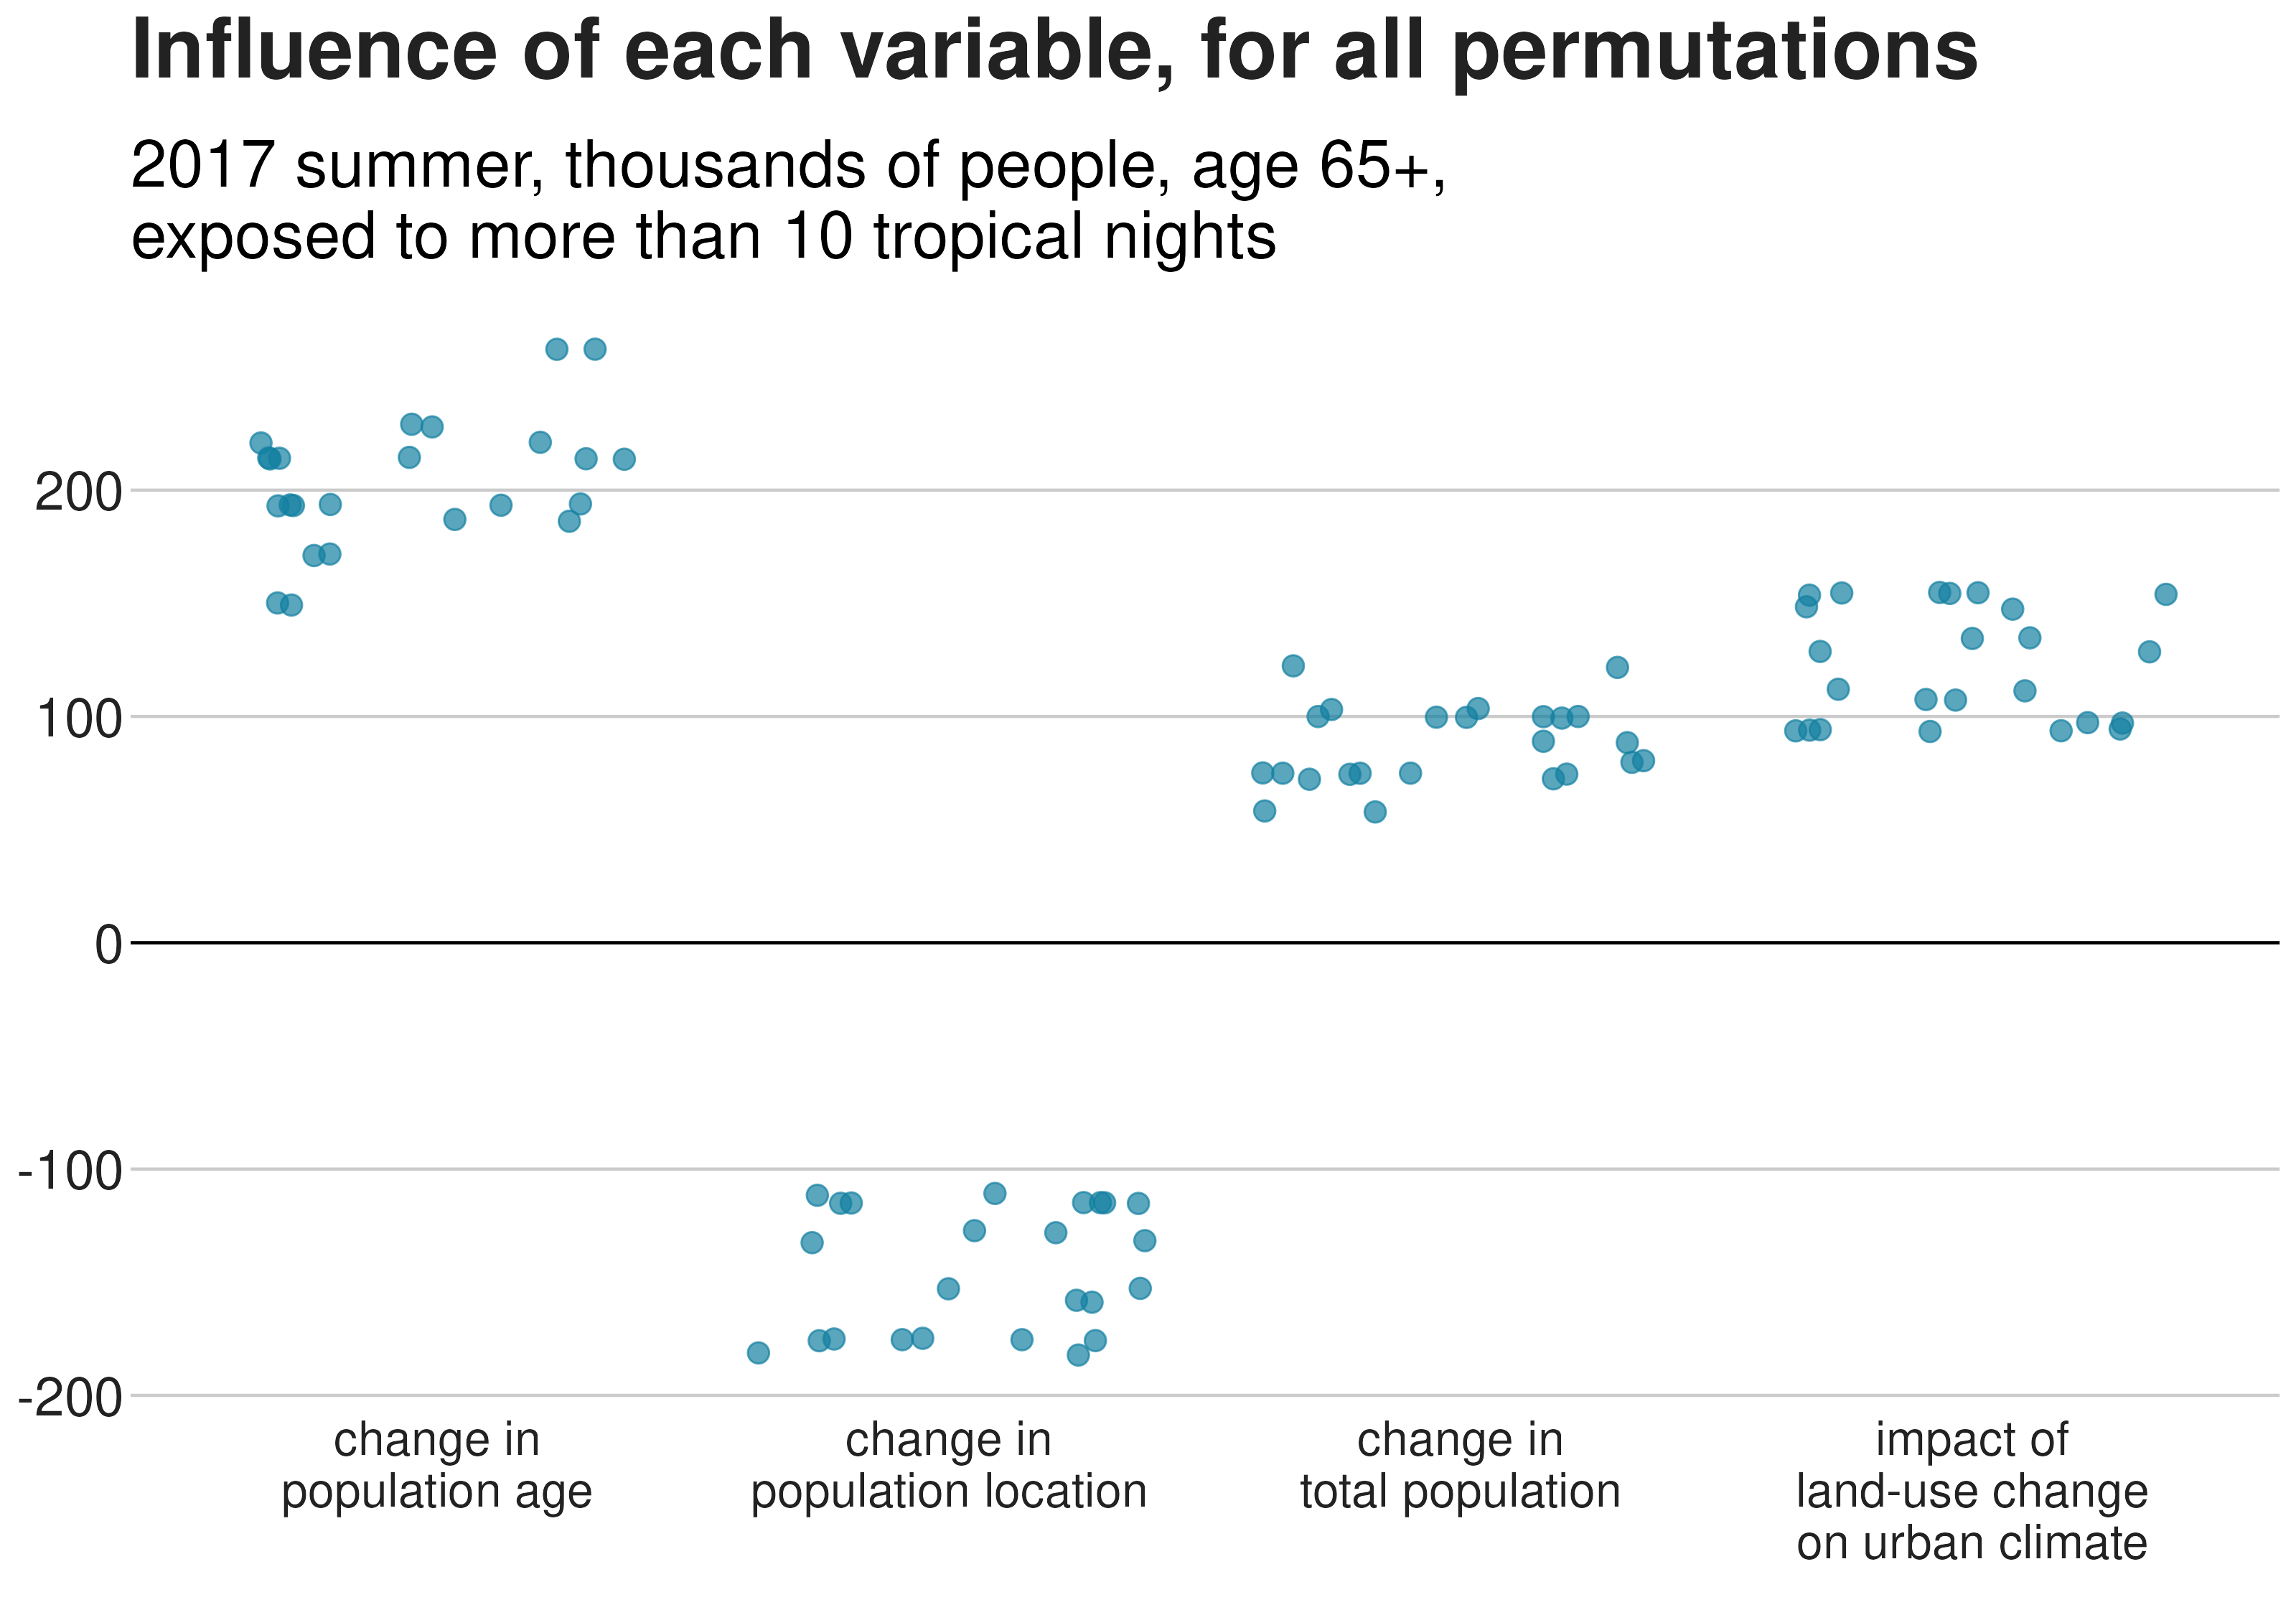
Various factors influence exposure to heat
Key message 1
In absolute terms, land use changes and changes in elderly people location play a significant role

Slide 9
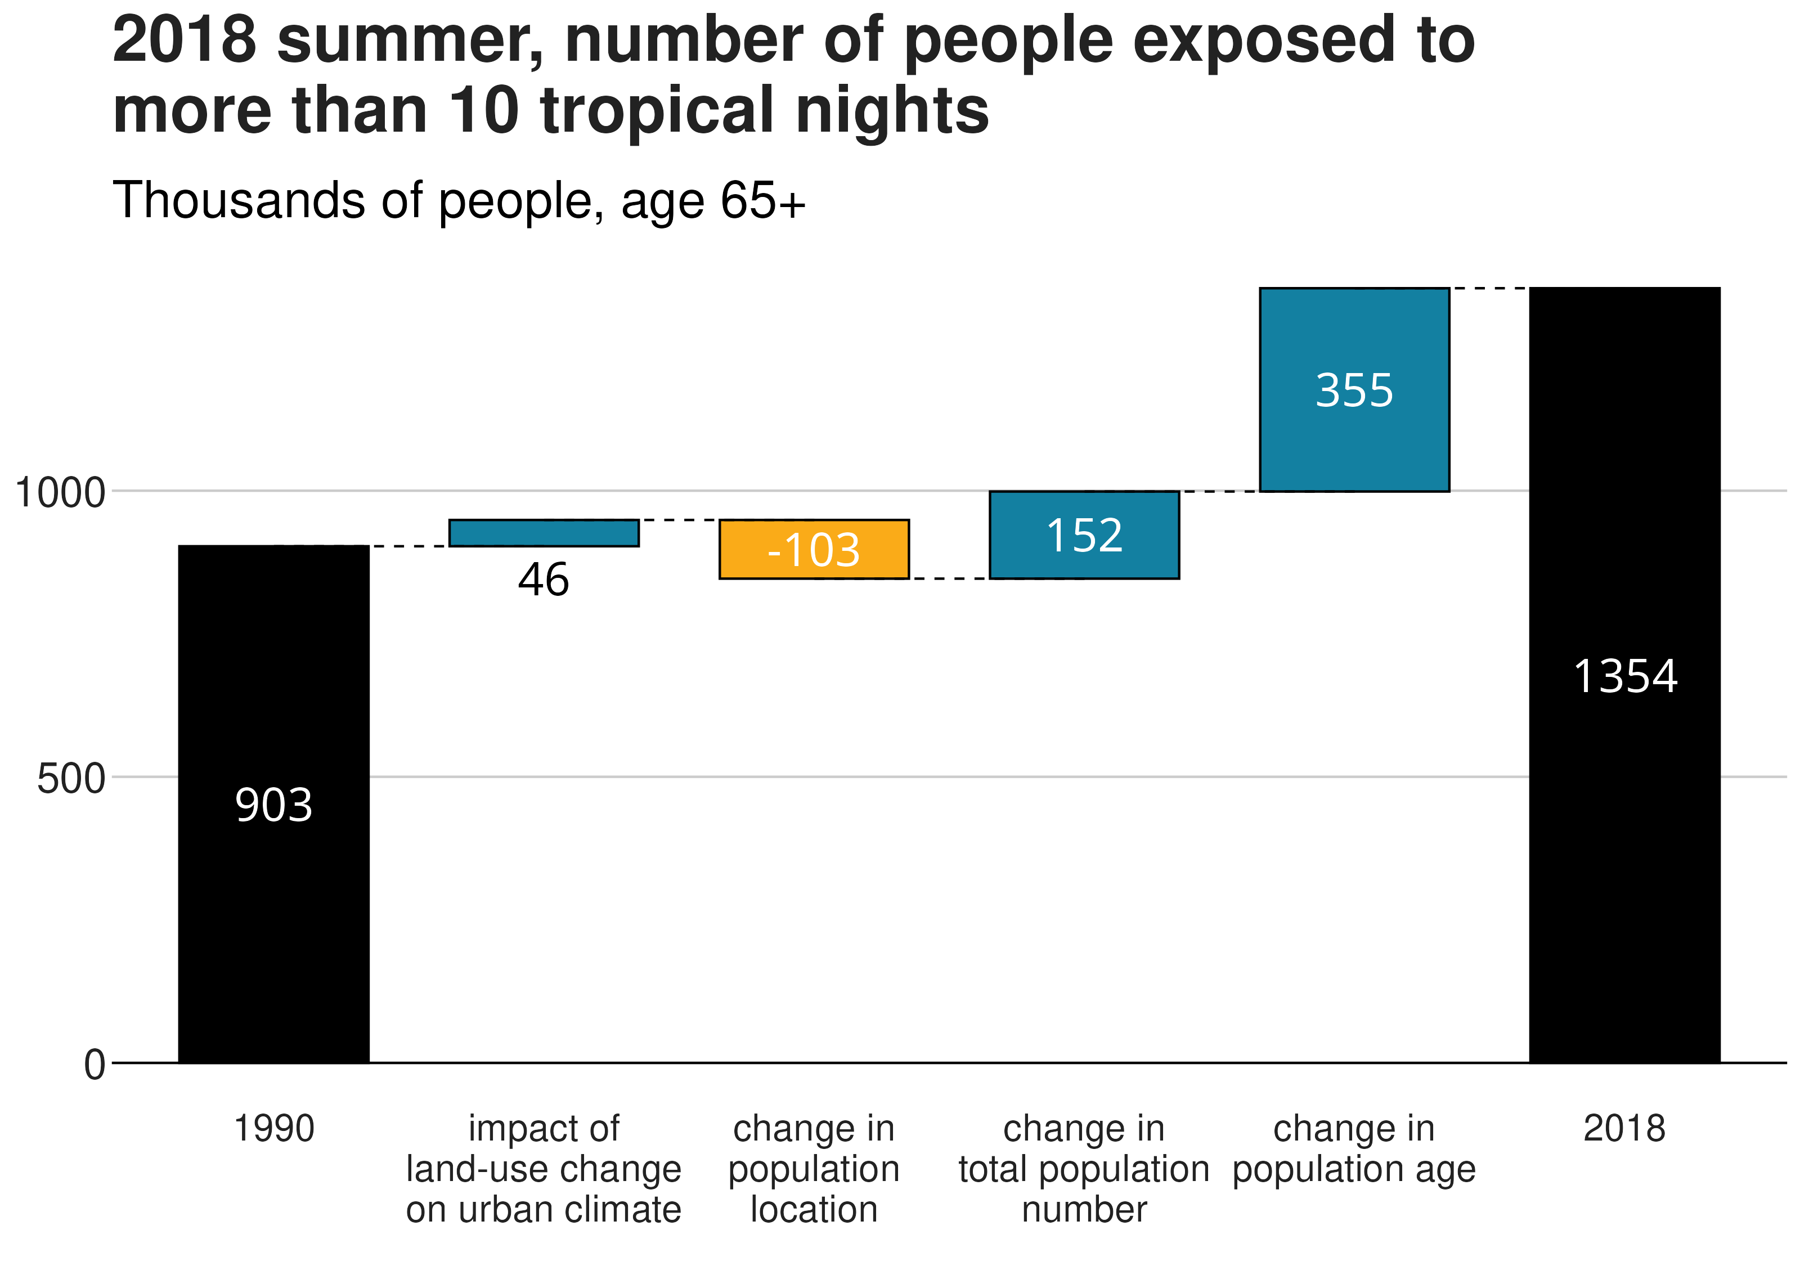

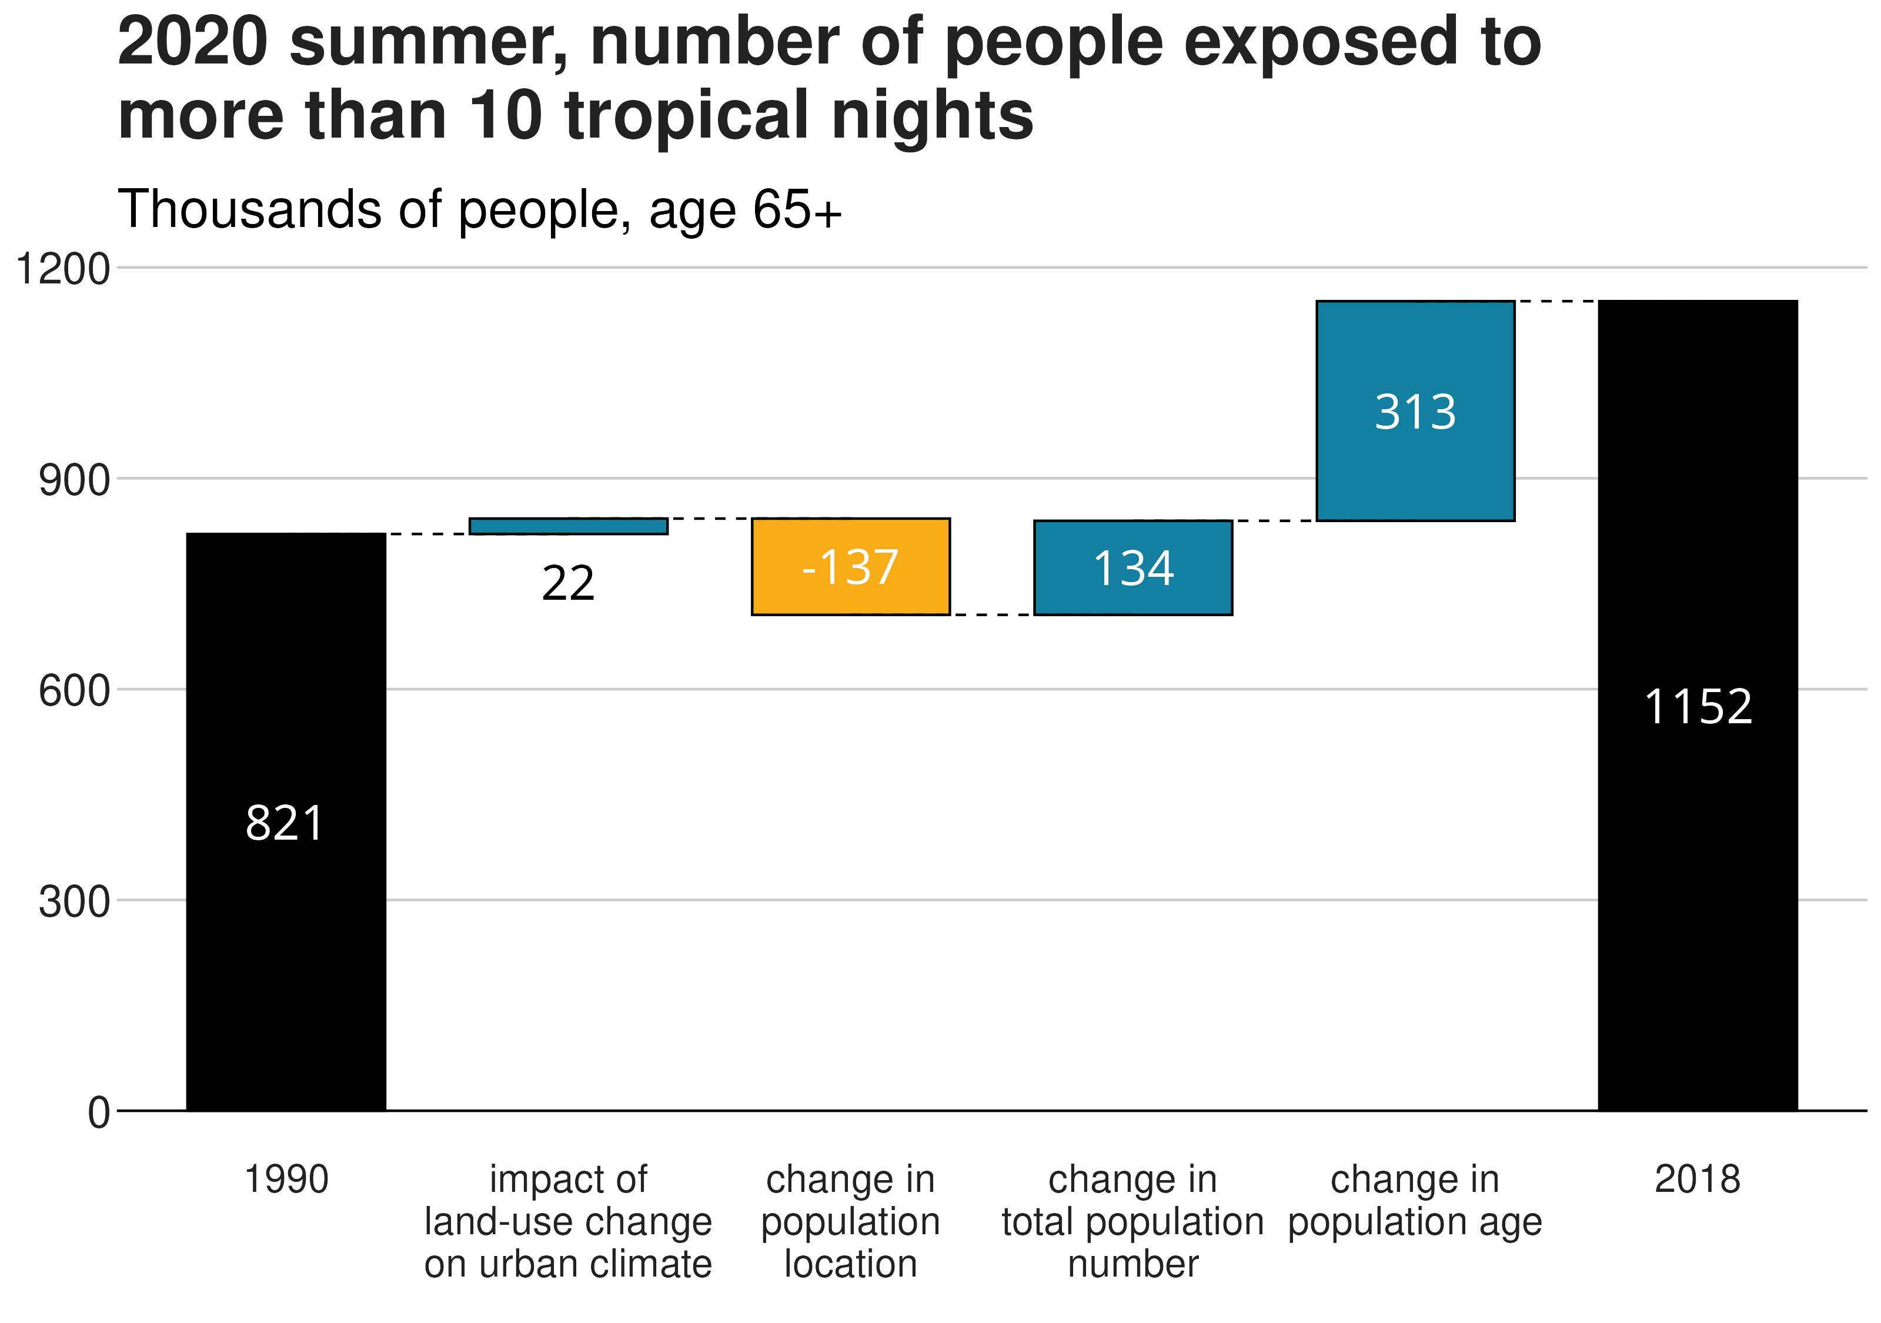
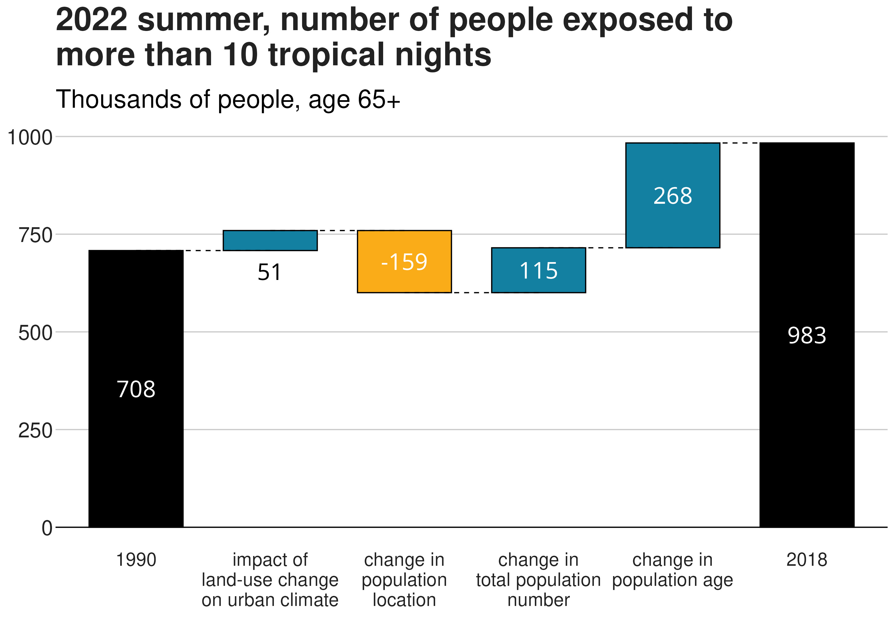
Key message 2
The influence of each factor depends on the characteristics of the heat waves

Slide 10
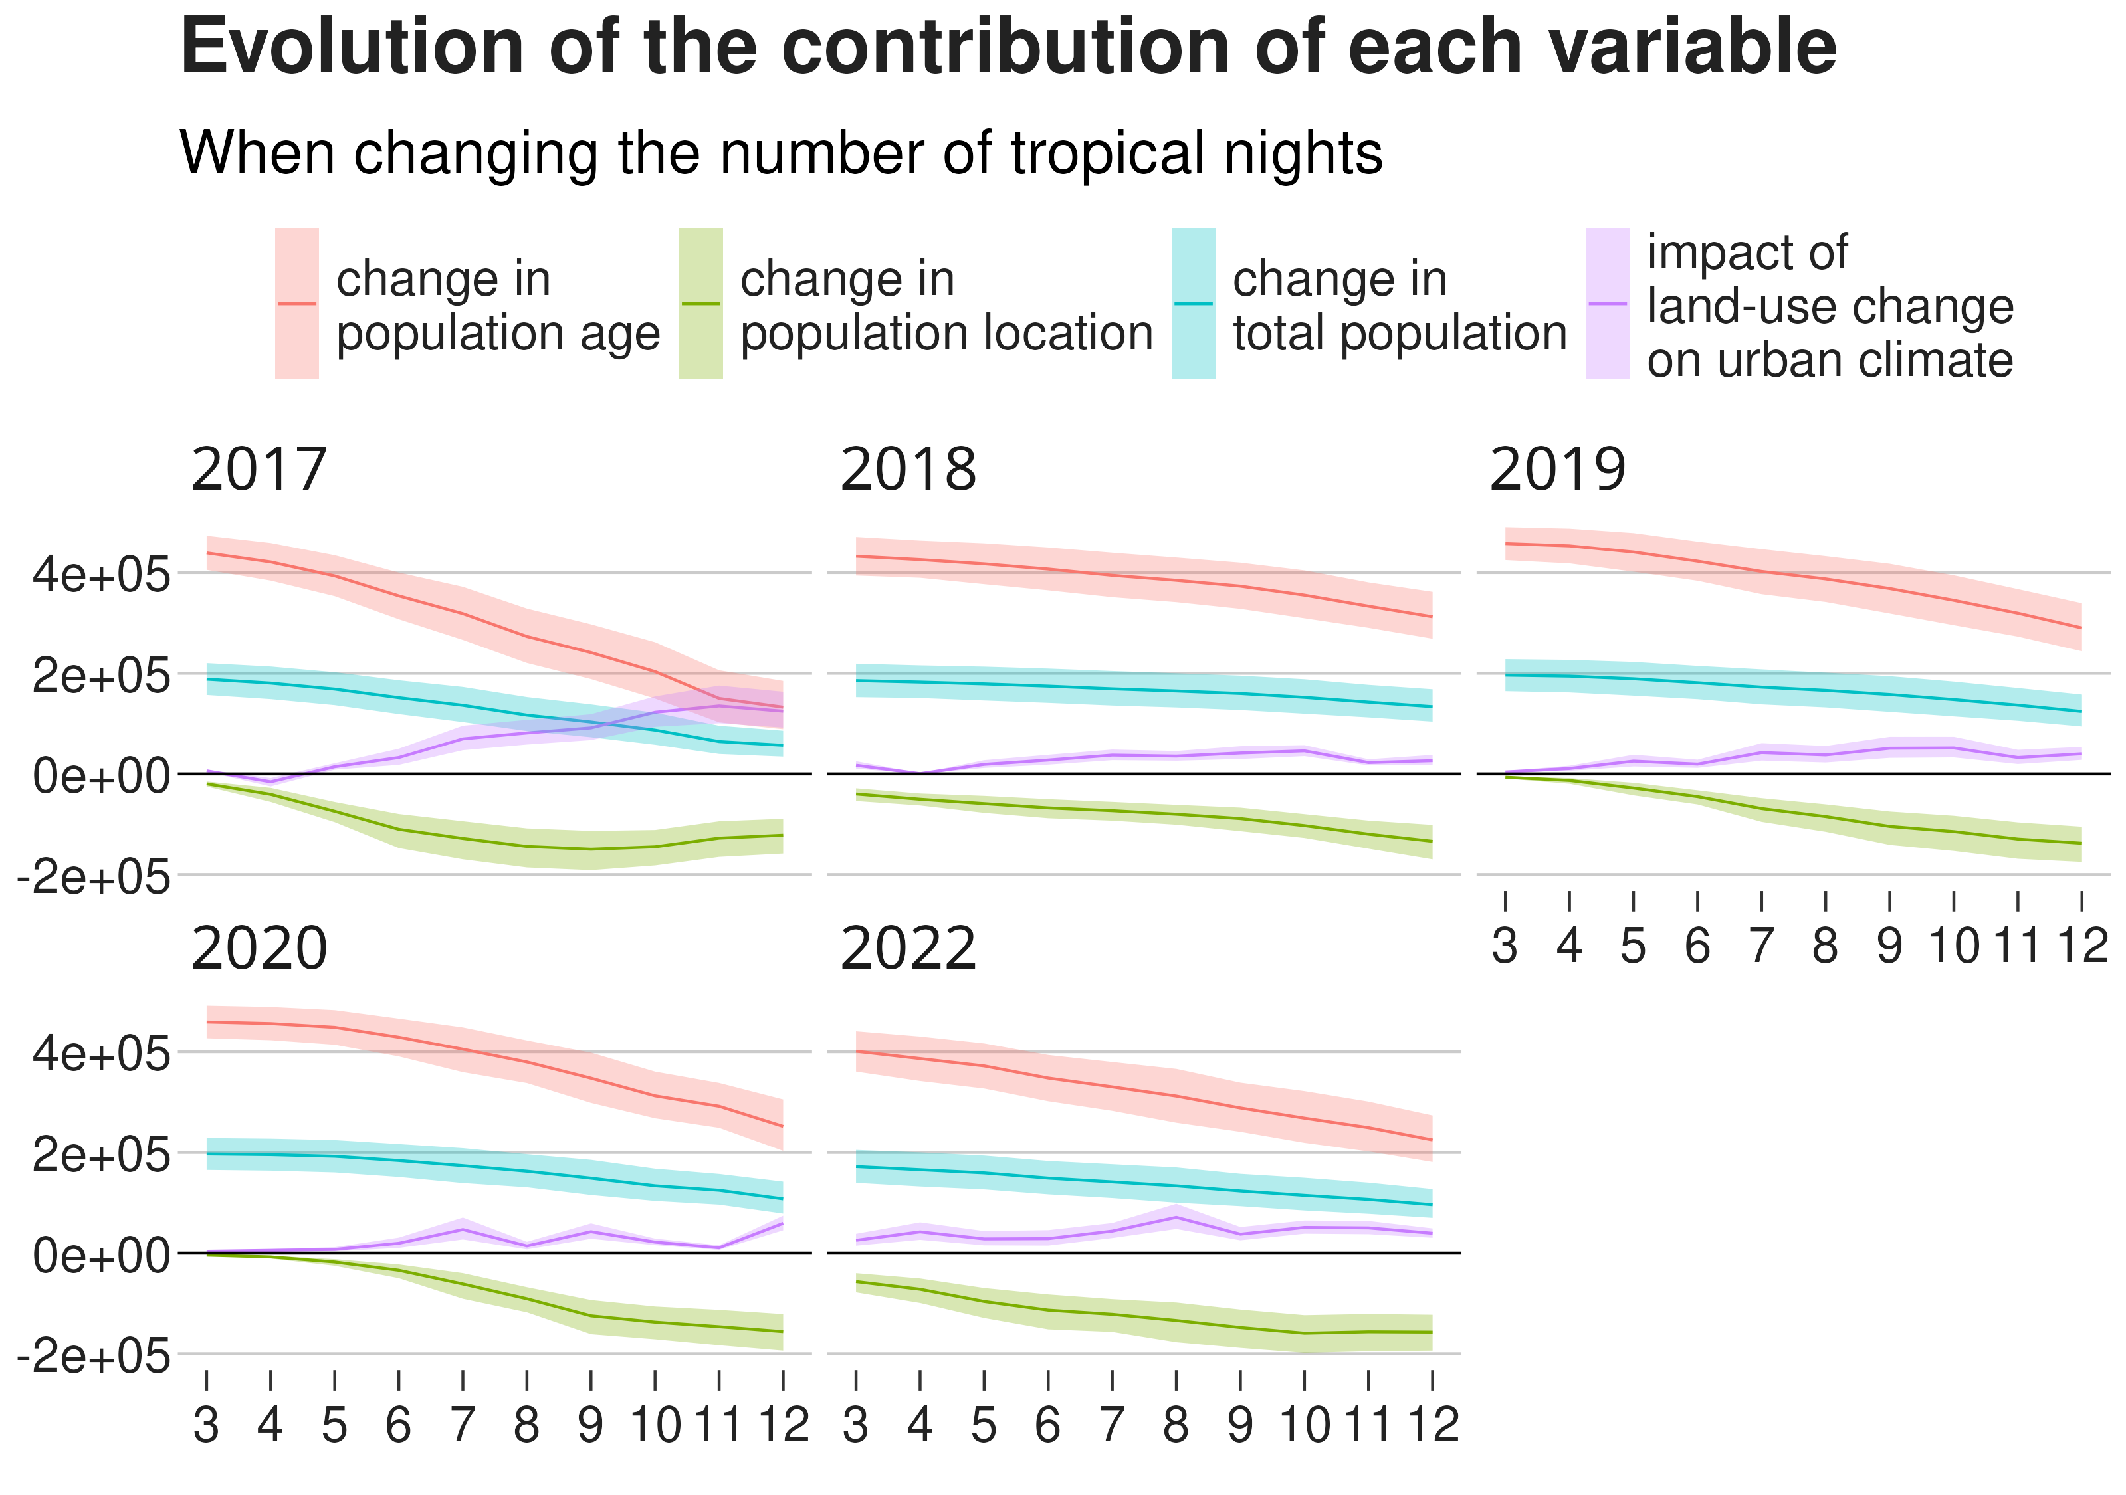
Key message 3
Local heterogeneities play a particularly big role for exposure to extreme heat conditions

